Slide 1
Making Presentations on employment preference
Based on the sample survey

Slide 2
Topic:employement preference by individuals
Conducted online sample survey and collected data
Processed and summarized the data
Analysed the data made slides for presentation

Slide 3
Questions asked in survey
1.FULL NAME
2.AGE
3.GENDER
4.DISTRICT
5.YOU ARE BELONGS TO ?(URBAN/RURAL)
6.QUALIFICATION
7.WHAT IS YOUR JOB PEFERENCE ?
PRIVATE SECTOR
GOVERNAMENT SECTOR
8.WHY DO YOU PREFFERED PRIVATE/GOVT JOB?(SECURITY/SALARY/RESPECT//FAMILY FORCE/PASSION)
9.WOULD YOU PREFER TO WORK?
WORK FROM OFFICE
WORK FROM HOME
BOTH FLEXIBLE

Slide 4

We understand what you priorities and make data useful

Slide 5

The survey is about individual preferences for there employement

Slide 6

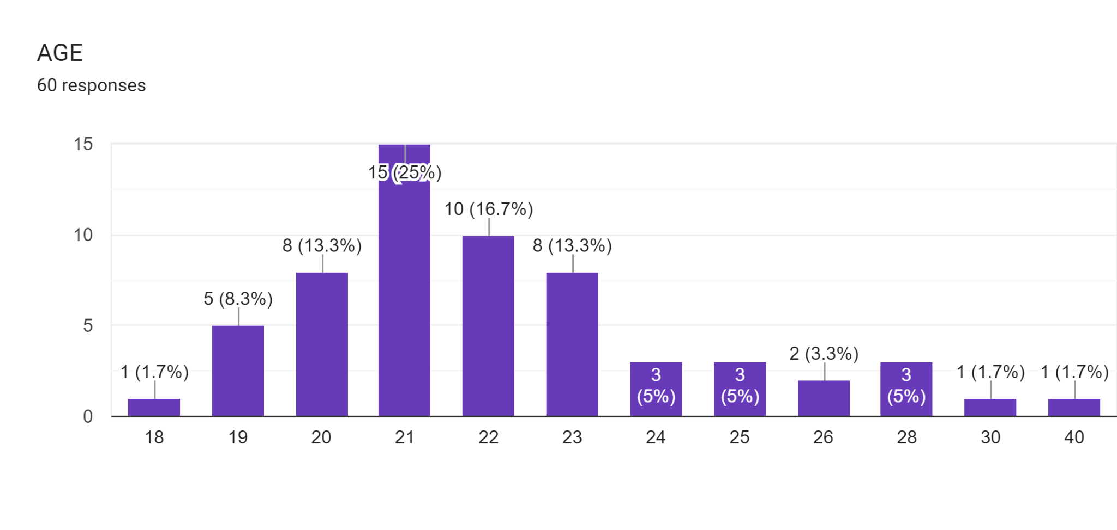
Age wise preference for employment

Slide 7
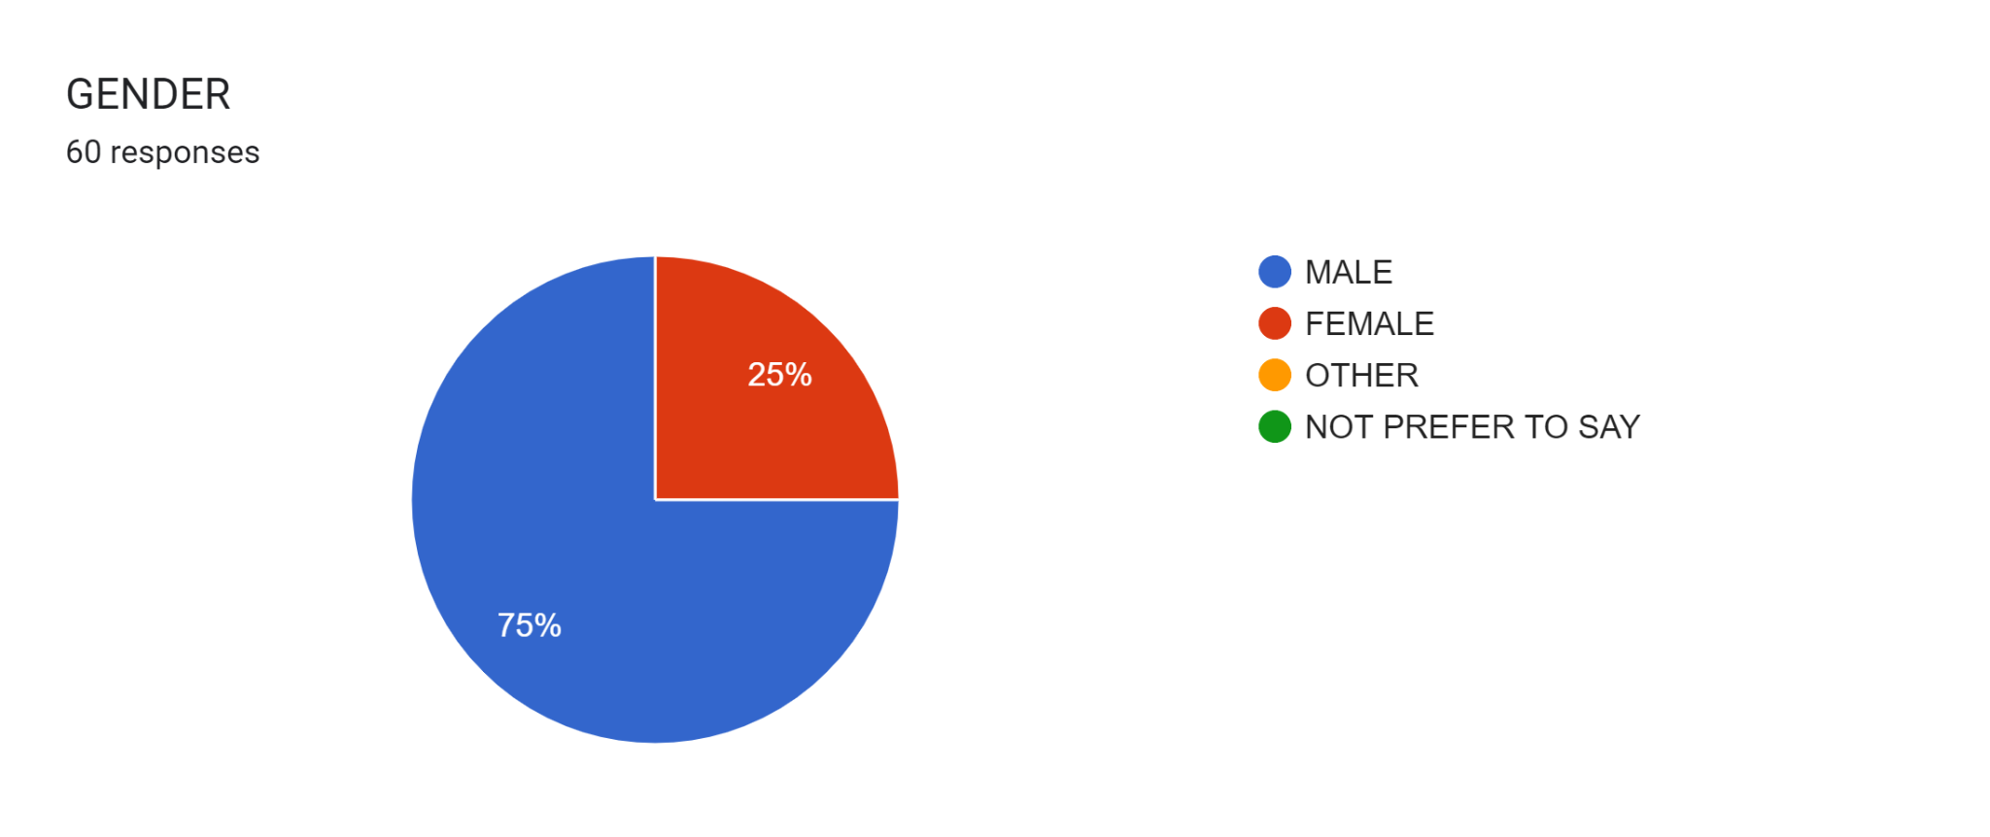
Gender wise employment preference

Slide 8
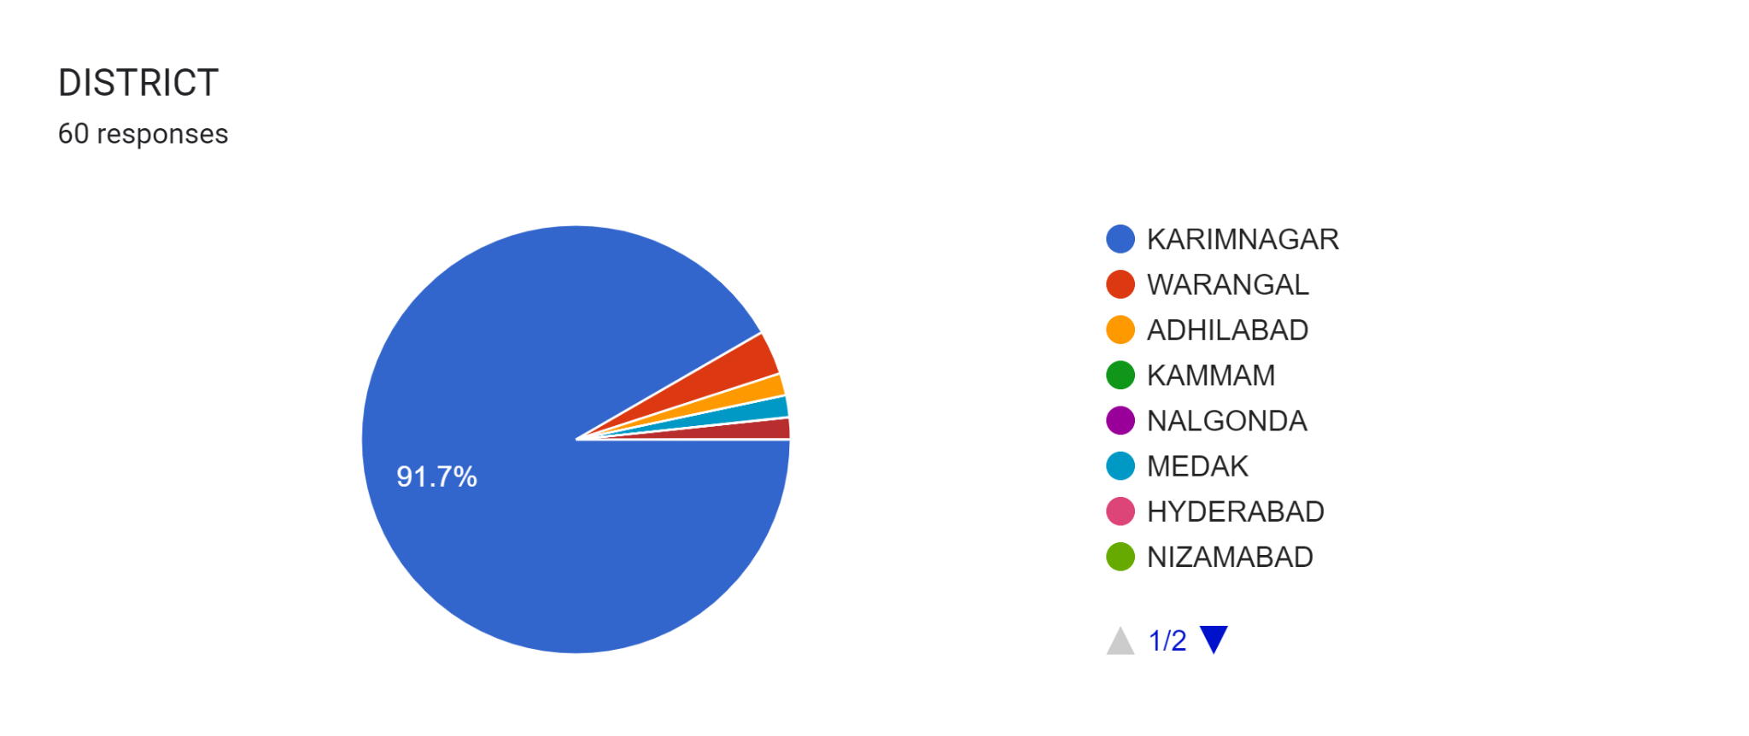

Just one! Your own.
(With a little help from your smart phone)
District wise employment preference
Tip
Remember. If something sounds like common sense, people will ignore it.
Highlight what is unexpected about your topic.

Slide 9
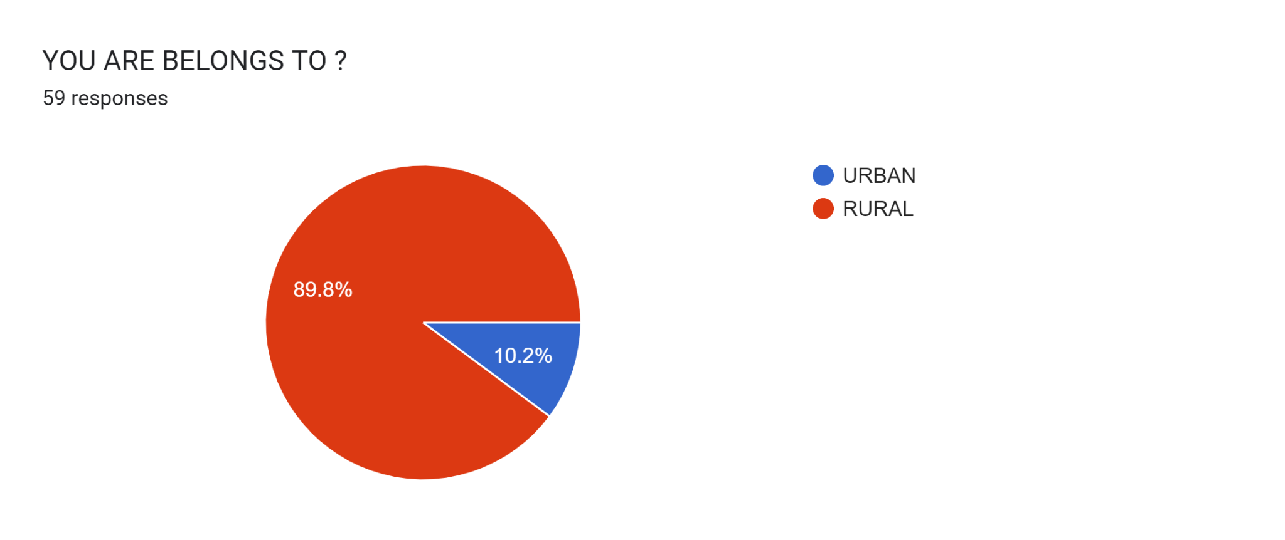
Area wise employment preference

Slide 10
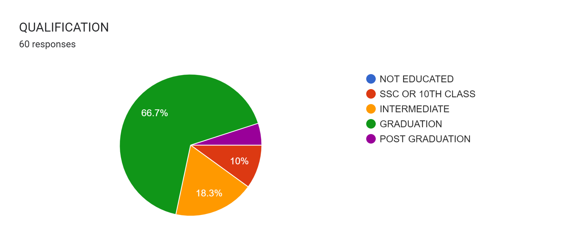
Qualification wise employment preference

Slide 11
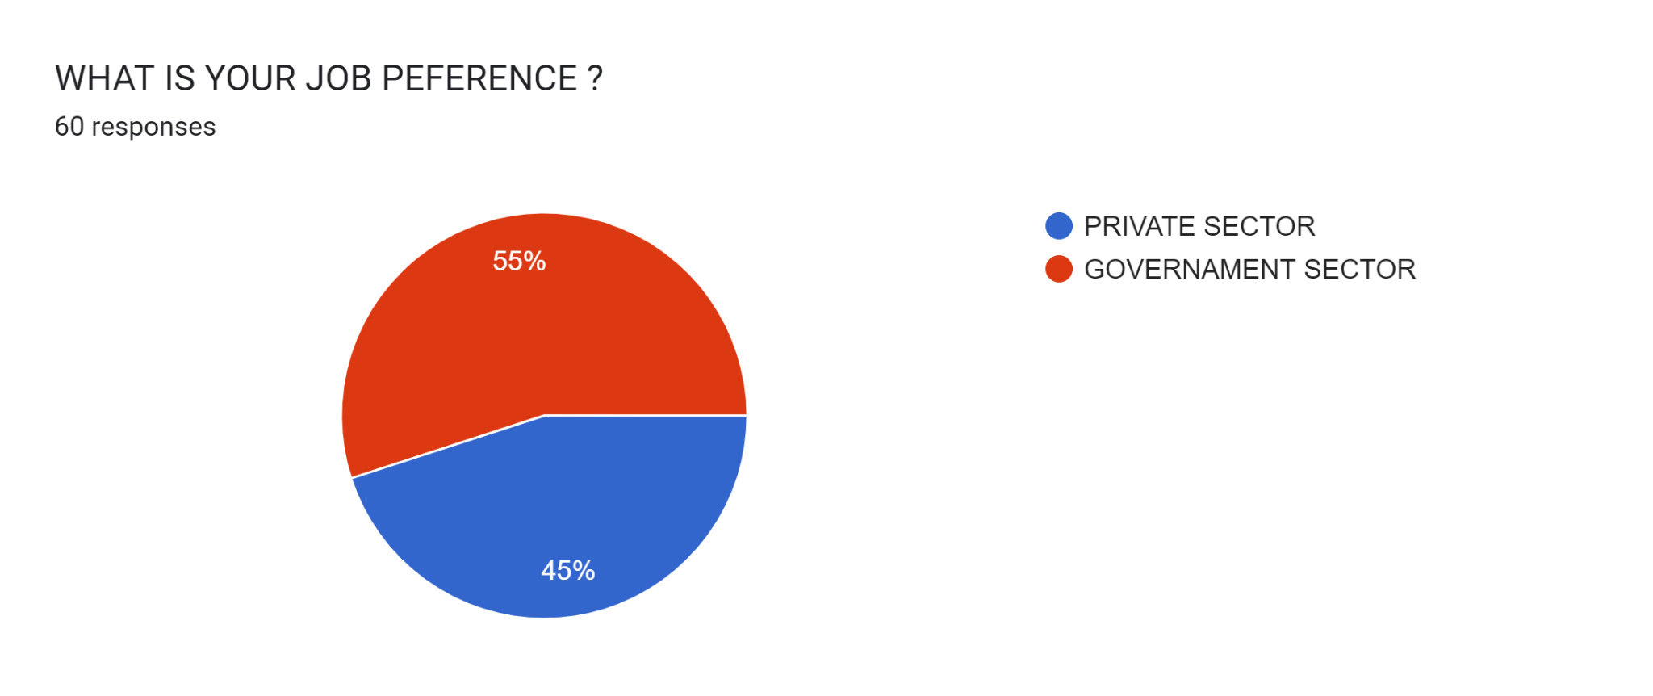
People preference to sectors

Slide 12
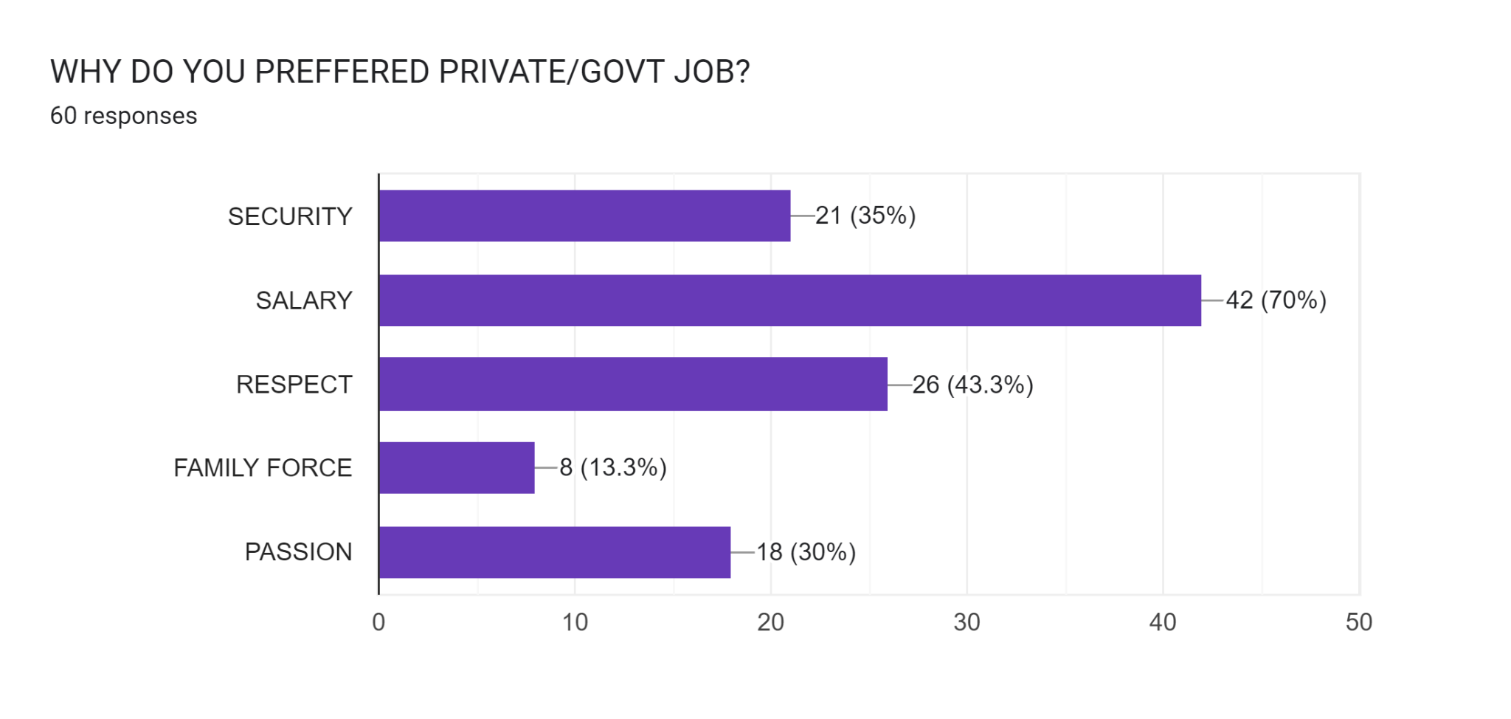
People preferring job for__________

Slide 13
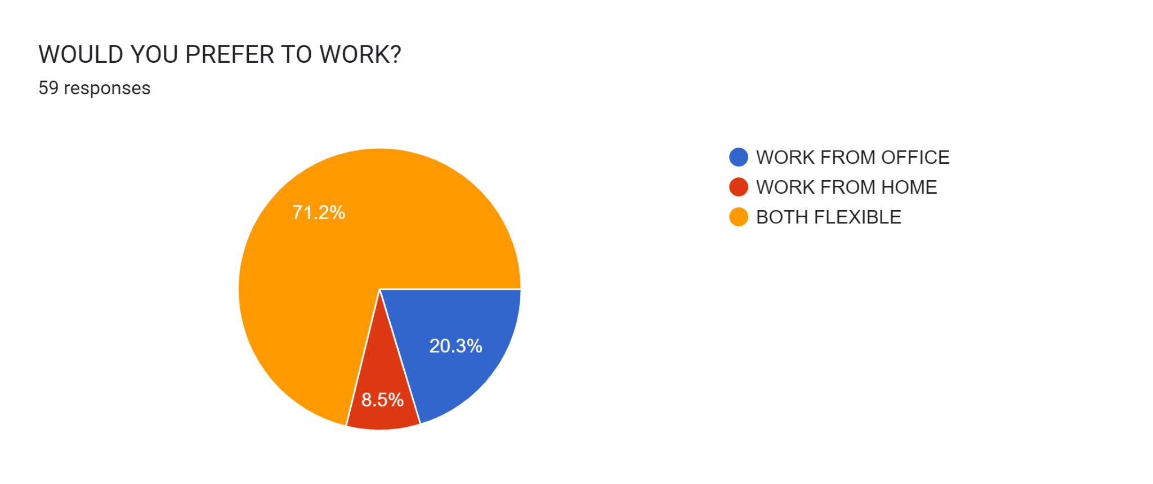
Peoples preference for working
Story for illustration purposes only

Slide 14
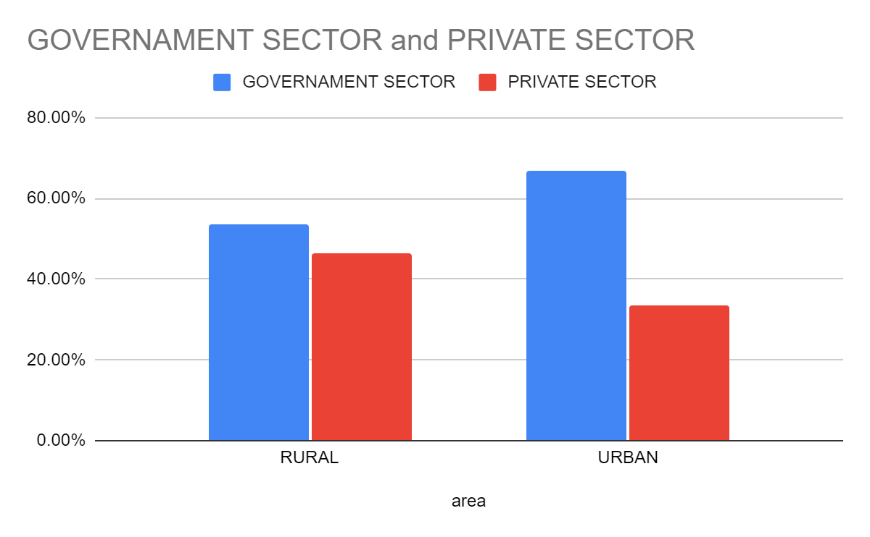
Area wise job preference in sector

Slide 15
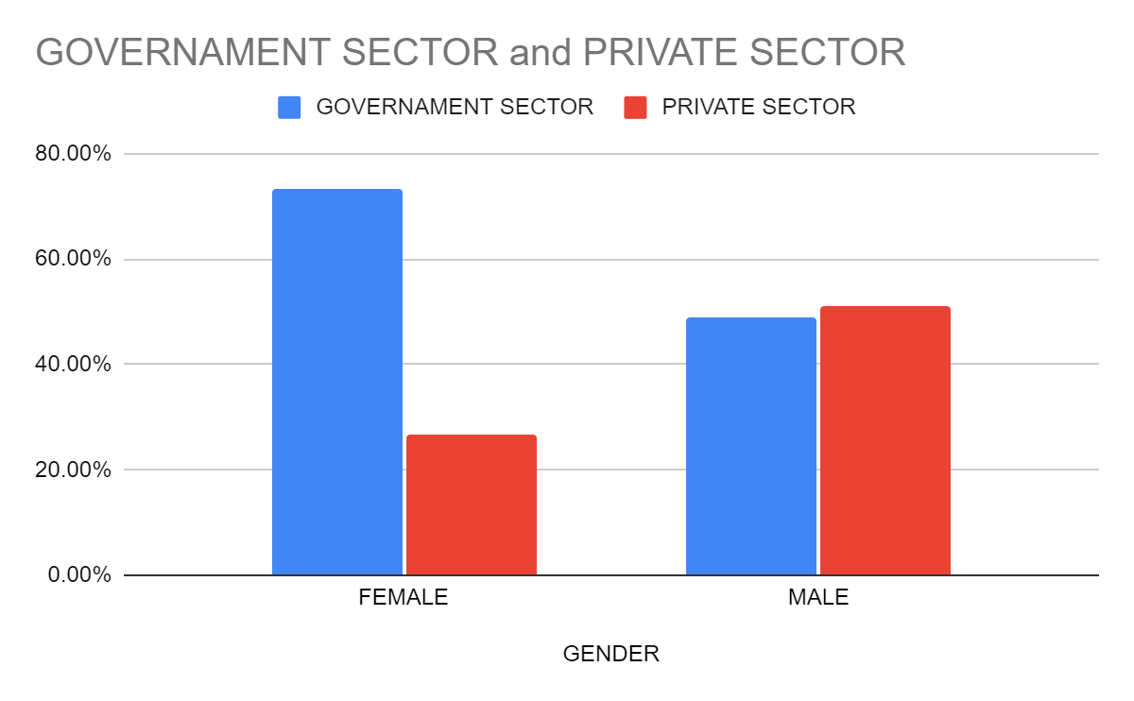
Gender wise job preference in sector

Slide 16
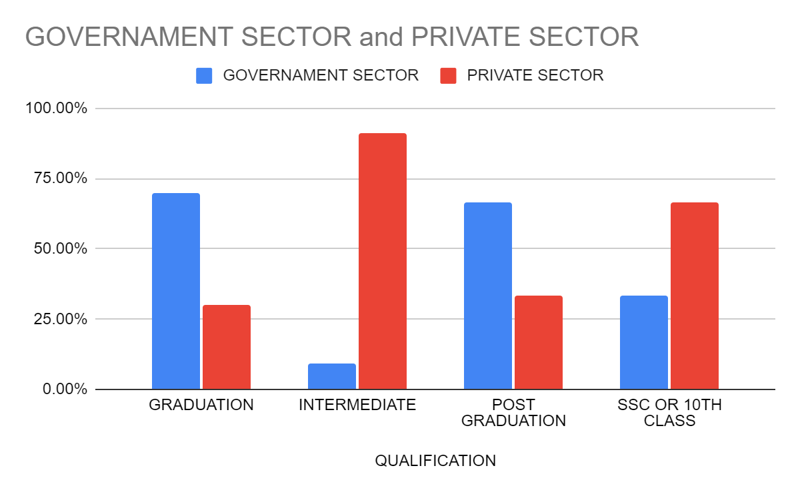
Qualification wise employment preference in sector

Slide 17
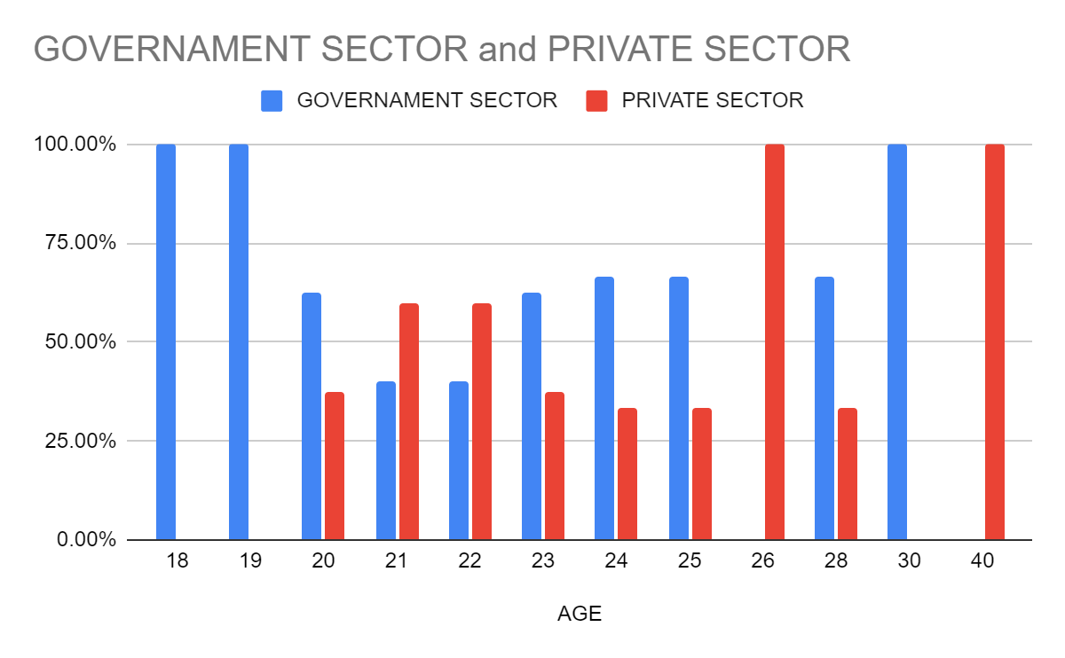
Age wise preffering job in sectors

Slide 18
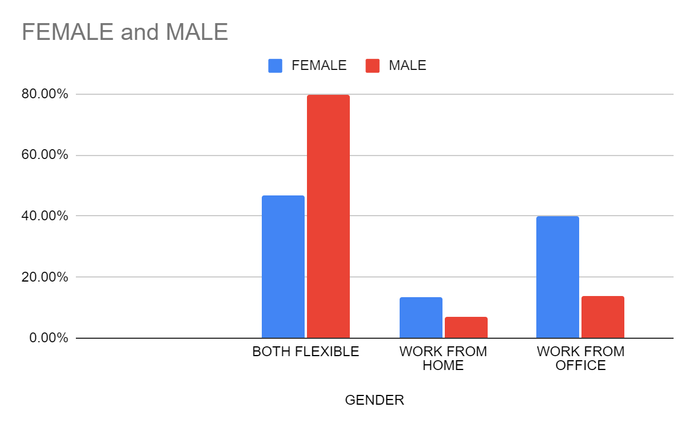
Gender wise preferring work from

Slide 19
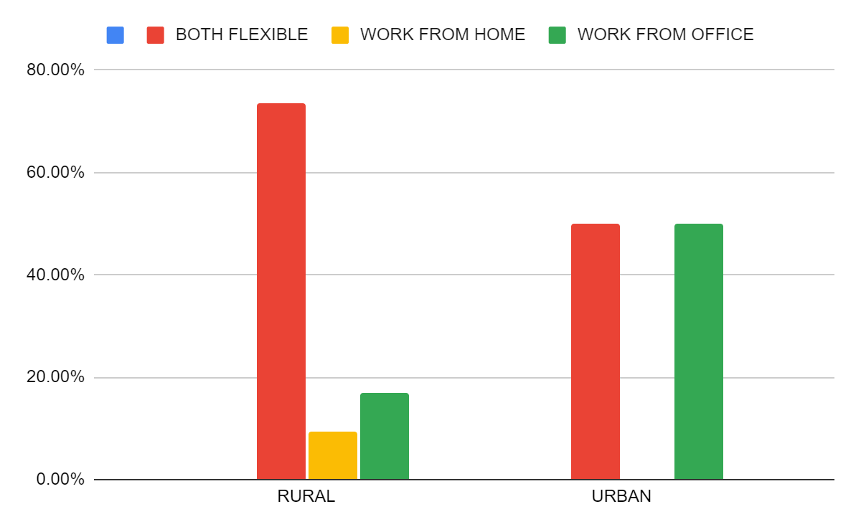
Area wise preferring work from

Slide 20
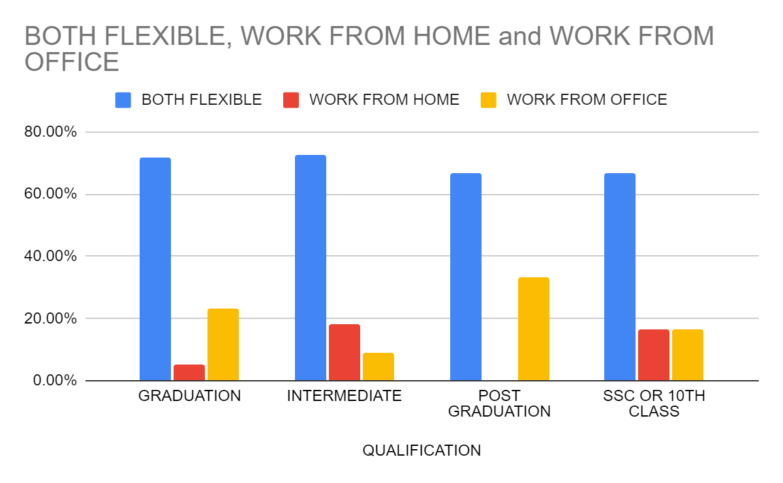
Qualification wise perefering to work from

Slide 21
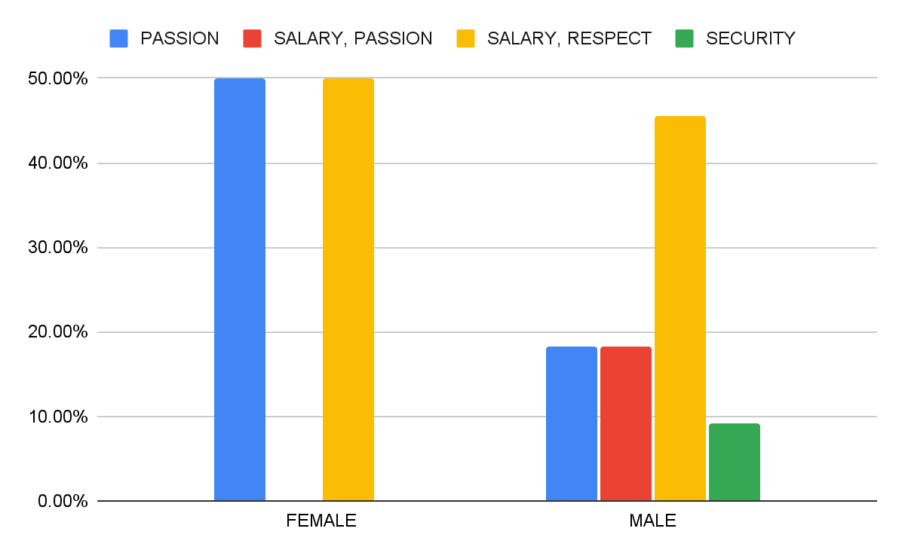
Gender wise prefering governament jobs for purpose

Slide 22

Gender wise preferening private sector jobs

Slide 23
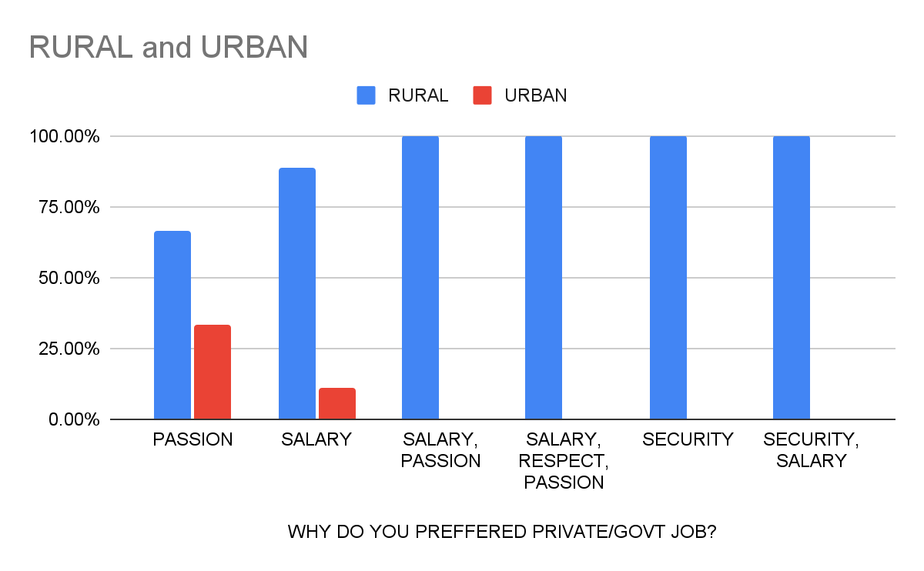
Area wise preferring govt job for those purpose

Slide 24
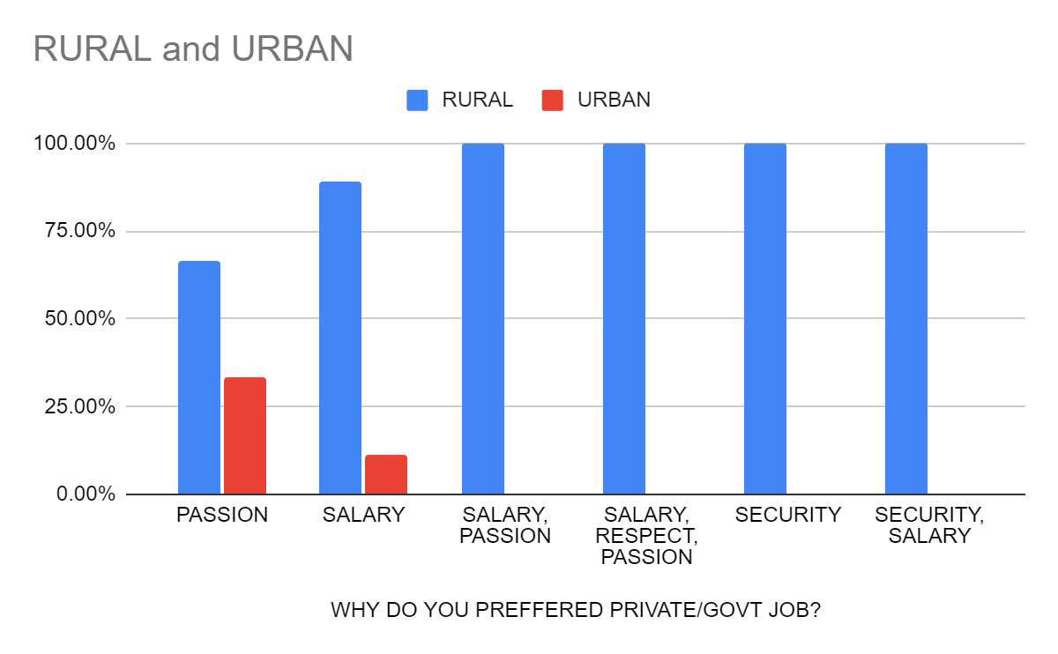
Area wise preferring private jobs for purpose

